Slide 1
Digital Design & Computer Arch. Lecture 18c: Fine-Grained Multithreading
Prof. Onur Mutlu
ETH Zürich
Spring 2020
30 April 2020

Slide 2
Approaches to (Instruction-Level) Concurrency
Pipelining
Out-of-order execution
Dataflow (at the ISA level)
Superscalar Execution
VLIW
Systolic Arrays
Decoupled Access Execute
Fine-Grained Multithreading
SIMD Processing (Vector and array processors, GPUs)

Slide 3
Recall: How to Handle Data Dependences
Anti and output dependences are easier to handle
write to the destination in one stage and in program order
Flow dependences are more interesting
Five fundamental ways of handling flow dependences
Detect and wait until value is available in register file
Detect and forward/bypass data to dependent instruction
Detect and eliminate the dependence at the software level
No need for the hardware to detect dependence
Predict the needed value(s), execute “speculatively”, and verify
Do something else (fine-grained multithreading)
No need to detect

Slide 4
How to Handle Control Dependences
Critical to keep the pipeline full with correct sequence of dynamic instructions.
Potential solutions if the instruction is a control-flow instruction:
Stall the pipeline until we know the next fetch address
Guess the next fetch address (branch prediction)
Employ delayed branching (branch delay slot)
Do something else (fine-grained multithreading)
Eliminate control-flow instructions (predicated execution)
Fetch from both possible paths (if you know the addresses of both possible paths) (multipath execution)

Slide 5
Fine-Grained Multithreading

Slide 6
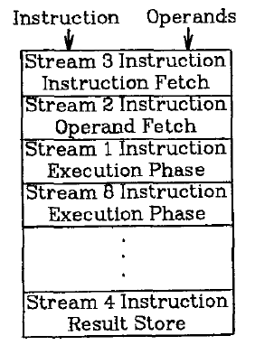
Fine-Grained Multithreading
Idea: Hardware has multiple thread contexts (PC+registers). Each cycle, fetch engine fetches from a different thread.
By the time the fetched branch/instruction resolves, no instruction is fetched from the same thread
Branch/instruction resolution latency overlapped with execution of other threads’ instructions
+ No logic needed for handling control and
data dependences within a thread
-- Single thread performance suffers
-- Extra logic for keeping thread contexts
-- Does not overlap latency if not enough
threads to cover the whole pipeline
Notes:
Latency overlap/hiding

Slide 7
Fine-Grained Multithreading (II)
Idea: Switch to another thread every cycle such that no two instructions from a thread are in the pipeline concurrently
Tolerates the control and data dependency latencies by overlapping the latency with useful work from other threads
Improves pipeline utilization by taking advantage of multiple threads
Thornton, “Parallel Operation in the Control Data 6600,” AFIPS 1964.
Smith, “A pipelined, shared resource MIMD computer,” ICPP 1978.

Slide 8
Fine-Grained Multithreading: History
CDC 6600’s peripheral processing unit is fine-grained multithreaded
Thornton, “Parallel Operation in the Control Data 6600,” AFIPS 1964.
Processor executes a different I/O thread every cycle
An operation from the same thread is executed every 10 cycles
Denelcor HEP (Heterogeneous Element Processor)
Smith, “A pipelined, shared resource MIMD computer,” ICPP 1978.
120 threads/processor
available queue vs. unavailable (waiting) queue for threads
each thread can have only 1 instruction in the processor pipeline; each thread independent
to each thread, processor looks like a non-pipelined machine
system throughput vs. single thread performance tradeoff

Slide 9
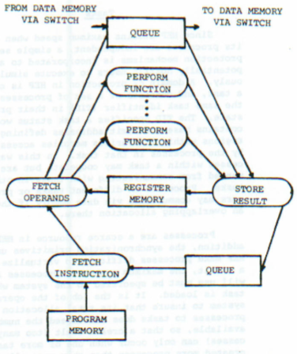
Fine-Grained Multithreading in HEP
Cycle time: 100ns
8 stages → 800 ns to complete an instruction
assuming no memory access
No control and data dependency checking
Burton Smith
(1941-2018)

Slide 10
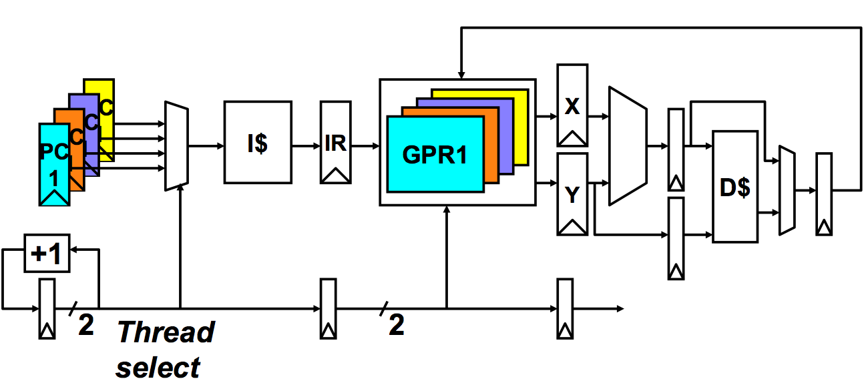
Multithreaded Pipeline Example
Slide credit: Joel Emer

Slide 11
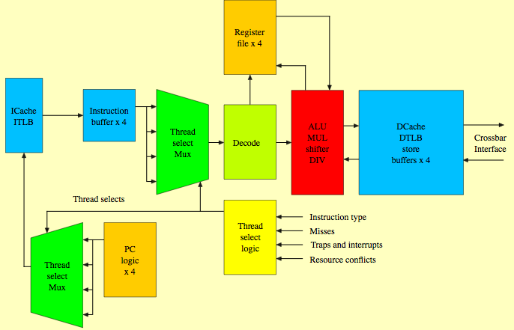
Sun Niagara Multithreaded Pipeline
Kongetira et al., “Niagara: A 32-Way Multithreaded Sparc Processor,” IEEE Micro 2005.

Slide 12
Fine-grained Multithreading
Advantages
+ No need for dependency checking between instructions
(only one instruction in pipeline from a single thread)
+ No need for branch prediction logic
+ Otherwise-bubble cycles used for executing useful instructions from different threads
+ Improved system throughput, latency tolerance, utilization
Disadvantages
- Extra hardware complexity: multiple hardware contexts (PCs, register files, …), thread selection logic
- Reduced single thread performance (one instruction fetched every N cycles from the same thread)
- Resource contention between threads in caches and memory
- Some dependency checking logic between threads remains (load/store)

Slide 13
Modern GPUs are FGMT Machines

Slide 14
NVIDIA GeForce GTX 285 “core”
64 KB of storage
for thread contexts (registers)
…
= data-parallel (SIMD) func. unit,
control shared across 8 units
= instruction stream decode
= multiply-add
= execution context storage
= multiply
Slide credit: Kayvon Fatahalian
Notes:
30 * 32 * 32 = 30 * 1024 = 30K fragments
64KB register file = 16 32-bit registers per thread = 64B (1/32 that of LRB)
16KB of shared scratch
80KB / core available to software

Slide 15
NVIDIA GeForce GTX 285 “core”
64 KB of storage
for thread contexts (registers)
…
Groups of 32 threads share instruction stream (each group is a Warp): they execute the same instruction on different data
Up to 32 warps are interleaved in an FGMT manner
Up to 1024 thread contexts can be stored
Slide credit: Kayvon Fatahalian
Notes:
To get maximal latency hiding:
Run 1/32 of the time
16 words per thread = 64B

Slide 16
NVIDIA GeForce GTX 285
Tex
Tex
…
…
…
…
…
…
Tex
Tex
…
…
…
…
…
…
Tex
Tex
…
…
…
…
…
…
Tex
Tex
…
…
…
…
…
…
Tex
Tex
…
…
…
…
…
…
30 cores on the GTX 285: 30,720 threads
Slide credit: Kayvon Fatahalian
Notes:
If you’re running a CUDA program, and your not launching 30K threads, you are certainly not getting full latency hiding, and you might not be using the GPU well

Slide 17
End of Fine-Grained Multithreading

Slide 18
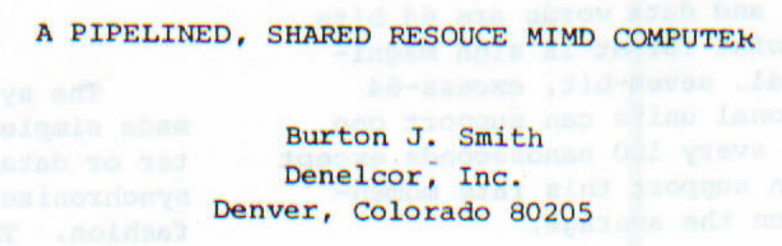
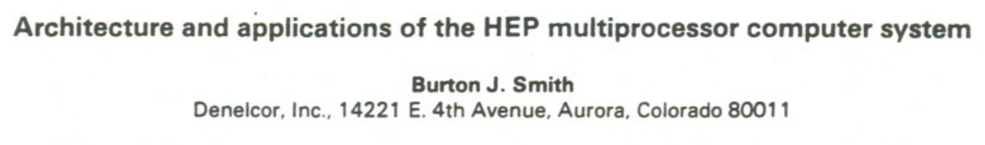
In Memory of Burton Smith
Burton Smith
(1941-2018)

Slide 19
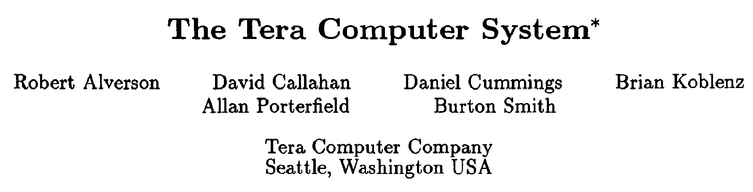
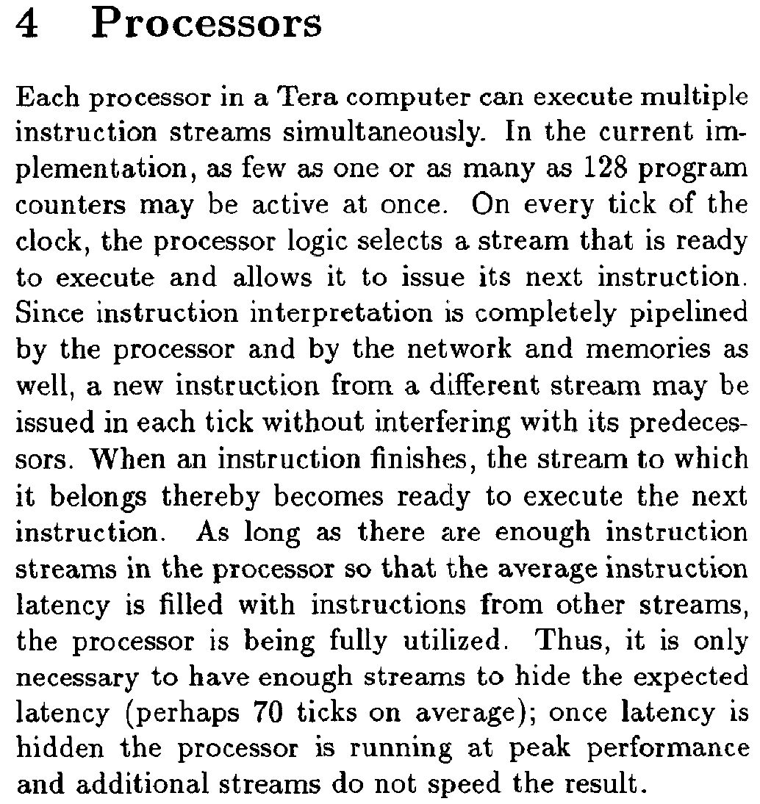
In Memory of Burton Smith (II)

Slide 20
Digital Design & Computer Arch. Lecture 18c: Fine-Grained Multithreading
Prof. Onur Mutlu
ETH Zürich
Spring 2020
30 April 2020

Slide 21
We did not cover the following slides in lecture. These are for your preparation for the next lecture.

Slide 22

Burton Smith
Technical Fellow at Microsoft
Past: Co-founder, chief scientist, chairman of Tera/Cray, Denelcor, Professor at Colorado
Eckert-Mauchly Award in 1991, Seymour Cray Award, US National Academy of Engineering, AAAS/ACM/IEEE Fellow and many other honors
Many wide-range contributions spanning architecture, system software, compilers, …, including:
Denelcor HEP, Tera MTA
fine-grained synchronization, communication, multithreading
parallel architectures, resource management, interconnection networks
…
One I would like to share:
Smith, “A pipelined, shared resource MIMD computer”, ICPP 1978.

